Slide 1
5G WIRELESS COMMUNICATION (UEC 719)
Course Instructor
Dr. Hem Dutt Joshi
Dr. Surbhi Sharma
Associate Professor,
TIET, Patiala

Slide 2
Lecture:
Space Time Block Code (STBC)

Slide 3
Space–time Block codes (STBC)
The decoding complexity of space time trellis codes (STTC) increases exponentially as a function of the diversity level and the transmission rate.
To address the issue of decoding complexity, Alamouti discovered an ingenious space–time block coding scheme for transmission with two antennas.

Slide 4
Transmit Beam Forming

Slide 5
Transmit beamforming is only
Possible when channel state information
Is available at transmitter
Hence, obtaining Tx Diversity is challenging compared to obtaining Rx Diversity

Slide 6
Space–time Block codes (STBC)
The decoding complexity of space time trellis codes (STTC) increases exponentially as a function of the diversity level and the transmission rate.
To address the issue of decoding complexity, Alamouti discovered an ingenious space–time block coding scheme for transmission with two antennas.
According to this scheme, input symbols are grouped in pairs where symbols
At time “k” → x(k) is transmitted from first antenna
and x(k+1) is transmitted from second antenna
At time “k+1” → - x*(k+1 is transmitted from 1st antenna
and x*(k) is transmitted from 2nd antenna
* → means Conjugate

Slide 7
Alamouti Code

Slide 8
Alamouti Code
Space time code Proposed for 1x2 wireless communication
Achieve a diversity order of 2 without CSI at the transmitter

Slide 9
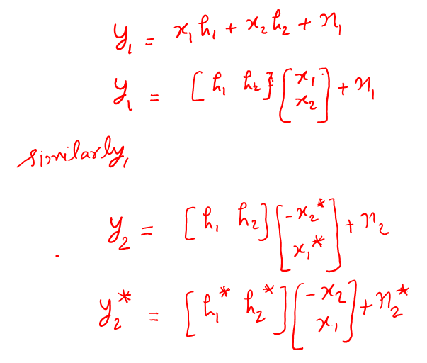

Slide 11
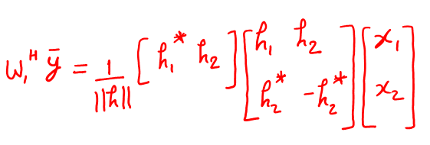
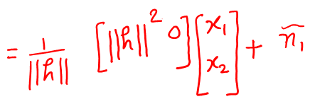
Receiver Beamforming

Slide 14
C1 and C2 are orthogonal.
Alamouti belongs to special class of codes Known as
“Orthogonal Space Time Block Codes”

Slide 15
